Slide 1
Design & Development of Registration
ASL
Last updated on 17 Dec 2021

Slide 2
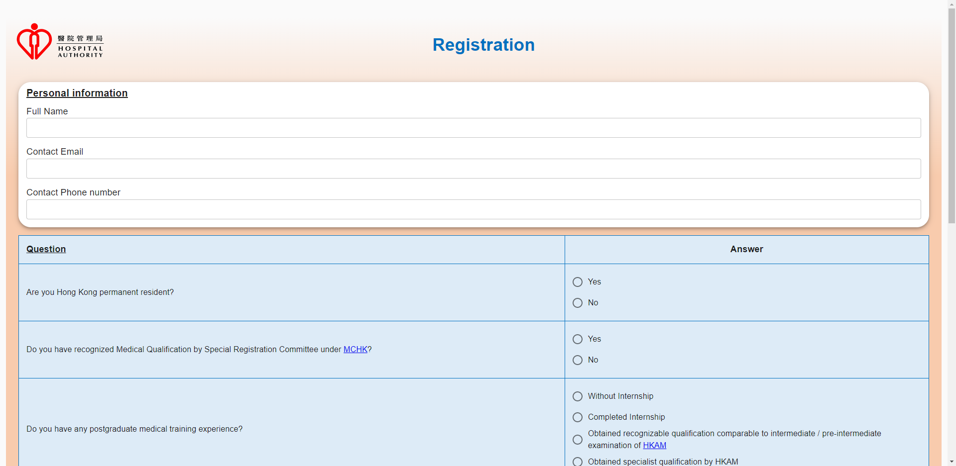
Proposed Screen
Registration Form (Part 1)

Slide 3
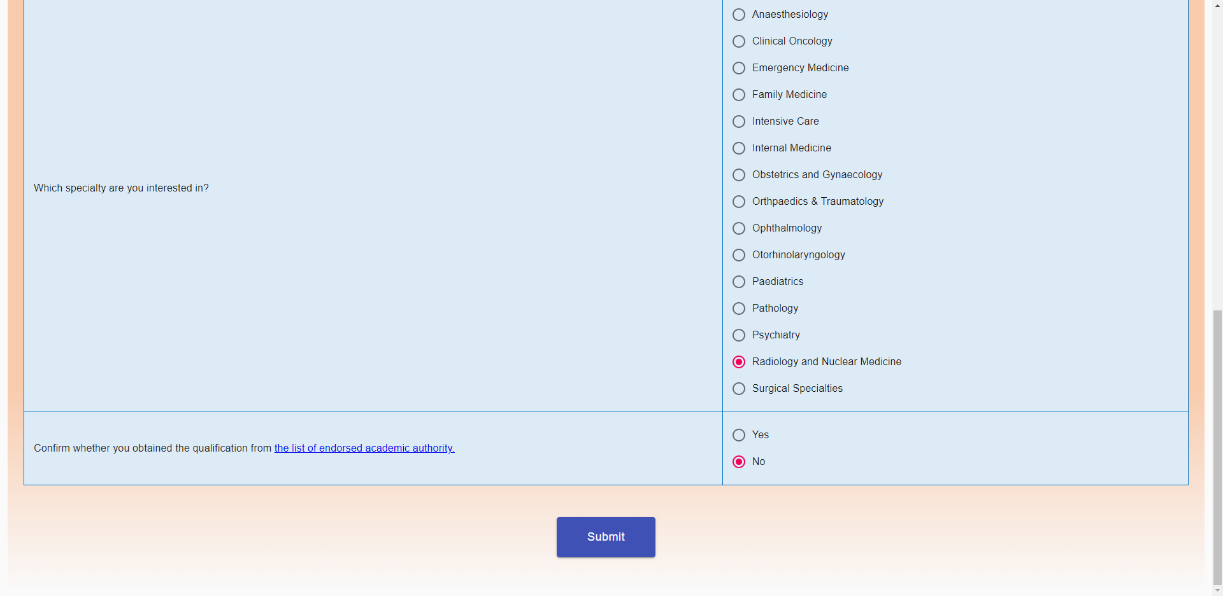
Proposed Screen
Registration Form (Part 1)

Slide 4
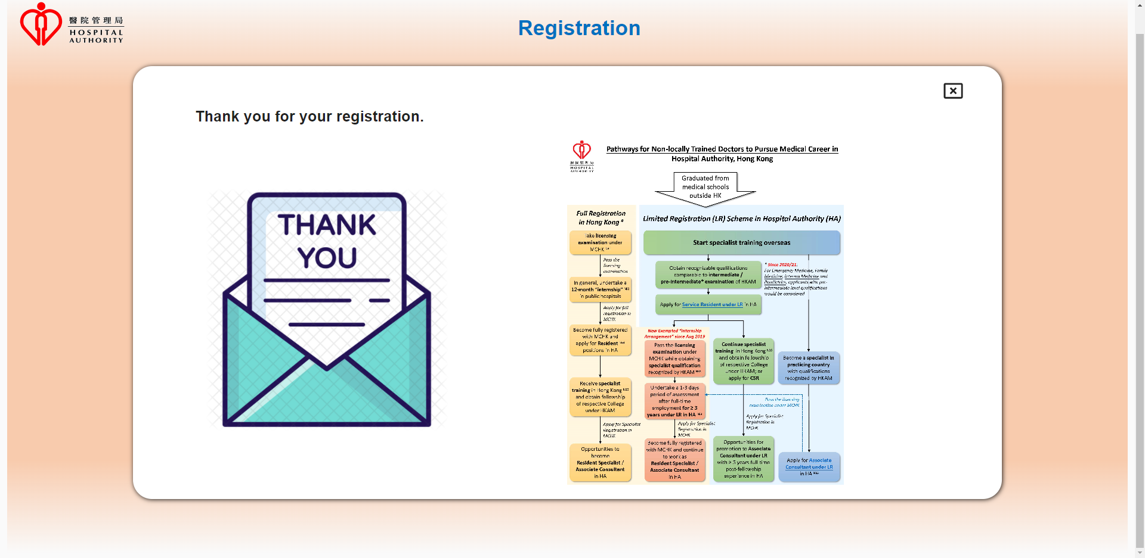
Proposed Screen
Result Page (Part 2)

Slide 5
Proposed Screen
Input Parameter of the Registration form
 | Description | Mandatory | Input | Max Length | Validation
Personal information
userName | Full Name | Yes | Inputbox | 255
email | Contact Email | Yes | Inputbox | 255
phoneNumber | Contact Phone number | Yes | Inputbox | 50
Question
question1 | Are you Hong Kong permanent resident? | Yes | Radio | 1
question2 | Do you have recognized Medical Qualification by Special Registration Committee under MCHK? | Yes | Radio | 1
question3 | Do you have any postgraduate medical training experience? | Yes | Radio | 1
question4 | Which specialty are you interested in? | Yes | Radio | 1
question5 | Confirm whether you obtained the qualification from the list of endorsed academic authority. | Yes | Radio | 1

Slide 6
Technology Involved
Backend
Spring Boot
Spring MVC
Maven
Eclipse
Java 8
Packaging (WAR)
Frontend
ReactJS
Material-ui

